Slide 1
Business Information System
INTRODUCTION TO BUSINESS INFORMATION SYSTEMS
Prepared by: Dr. T.M.Venthan

Slide 2
What is meant by data?
Data are raw facts or observations that are considered to have little or no value until they have been processed and transformed into information. A single piece of data is called a datum. Unrelated items of data are considered to be essentially without meaning and are often described as ‘noise’. It is only when data have been placed in some form of context that they become meaningful to a manager.

Slide 3
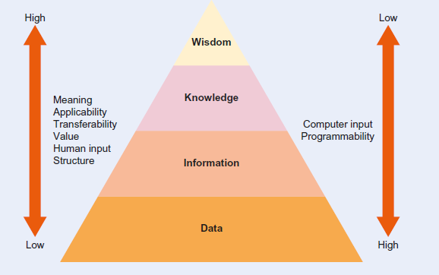
Figure 1.1 The ‘DIKW’ model

Slide 4
What is information?
As with the concept of data, there are several definitions of information that are in common use:
data that have been processed so that they are meaningful;
data that have been processed for a purpose;
data that have been interpreted and understood by the recipient.

Slide 5
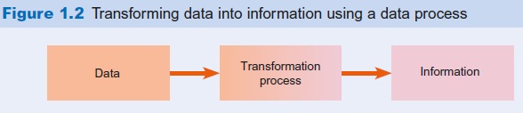
Transformation process
A transformation process is used to convert inputs into outputs.
Information need
Information is produced to meet a specific purpose or requirement.
Data process
A process used to convert data into information. Examples include summarising, classifying and sorting.

Slide 6
Tangible value
A value or benefit that can be measured directly, usually in monetary terms.
Intangible value
A value or benefit that is difficult or impossible to quantify.
Formal communication
Formal communication involves presenting information in a structured and consistent manner.
Informal communication
This describes less well-structured information that is transmitted by informal means, such as casual conversations between members of staff.

Slide 7
Attributes of information quality
A group of characteristics by which the quality of information can be assessed, normally grouped into categories of time, content and form.
Time dimension
Characteristics of information quality such as timeliness, currency and frequency which are related to the time of collection and review.
Content dimension
Characteristics of information quality such as accuracy, relevance and conciseness which are related to the scope and contents of the information.

Slide 8
Form dimension
Characteristics of information quality related to how the information is presented to the recipient.
proprietary
related to an owner or ownership.
Semantic web
Refers to information accessible via the Internet that is understandable by machines. Such information has been placed in a form that allows machines to understand the meaning of the information and its associations with other pieces of information.
Metadata
Additional information used to describe the content of a given item. Metadata is often described as ‘data about data’.

Slide 9
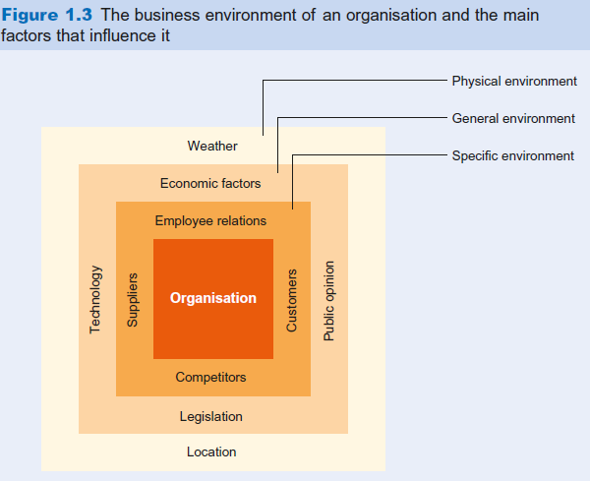
Knowledge
Knowledge can be thought of as the combined result of a person’s experiences and the information they possess.
Environment
All businesses operate within an environment that includes social, political and business influences.
the environment refers to the
external factors that influence the
operations

Slide 10
Business resource base
The resources that a company has available to it which are made up of physical and conceptual resources known as tangible and intangible assets.
Business resources are the assets and capabilities a company possesses or can access to conduct its operations and achieve its objectives.
Physical resources
Tangible assets or resources owned by a company such as land, buildings and plant.
Conceptual resources
Non-physical resources or intangible assets owned by a company, such as organisational knowledge.

Slide 11
Internal business resources
To operate within the business environment, organisations use a business resource base which supports their activities. The resource base consists of tangible resources (sometimes called ‘physical resources’) and intangible resources (sometimes called ‘conceptual resources’).
BIS can be applied to make best use of physical and conceptual resources to help an organisation to reduce costs, improve productivity and enhance overall efficiency.
Tangible assets (physical resource base)
Physical resources are often known as tangible assets and are normally directed towards the production of a product or service. Examples of physical resources include money, land, plant and labour power. The hardware and software making up BIS are also physical resources.
Intangible assets (conceptual resource base)
Conceptual resources are often known as intangible assets and are normally used to support an organisation’s activities, for example by helping managers to make better decisions. Examples of intangible resources include experience, motivation, knowledge,

Slide 12
Electronic business
(e-business) The use of information and communication technologies, particularly the Internet, to support day-to-day business activities.
Decision behaviour
The way in which managers make decisions.
Structured decisions
Situations where the rules and constraints governing the decision are known.
Unstructured decisions
Complex situations, where the rules governing the decision are complicated or unknown.
Cognitive style
This describes the way in which a manager absorbs information and reaches decisions. A manager’s cognitive style will fall between analytical and intuitive styles.
in business refers to an individual's preferred way of processing and organizing information, solving problems, and making decisions within a business context.

Slide 13
Quantitative data
Includes use of figures, such as statistics. Also known as hard data, often collected in order to measure or quantify an object or situation.
Qualitative data
Describe without the use of figures, the qualities or characteristics of an object or situation. Also known as soft data.
Business rule
A rule describing what action the organisation should take when a particular situation arises. As an example, a bank might have a rule specifying that customers applying for a loan will only be considered if they have held an account for three years or more.
Decision tree
A diagram showing the events, conditions and outcomes associated with making a business decision. The decision tree is a graphical representation of the decision-making process.
Decision table
A means of representing the logic of a decision. A matrix is used to show all contingencies and the actions to be taken for each.

